Slide 1
Machine Learning for Combustion Data Analysis
Abdennacer ZARGUIT

Slide 2
Presentation Outline
Introduction
Machine Learning Fundamentals
Case Study
Dimensionality Reduction
Clustering
Feature Selection
Clustering Interpretation
Conclusion

Slide 3
Introduction
Computing power capabilities
Data explosion
Conventional techniques are limited.
Identify patterns, make decisions, extract useful information
New field of science to tackle data

Slide 4
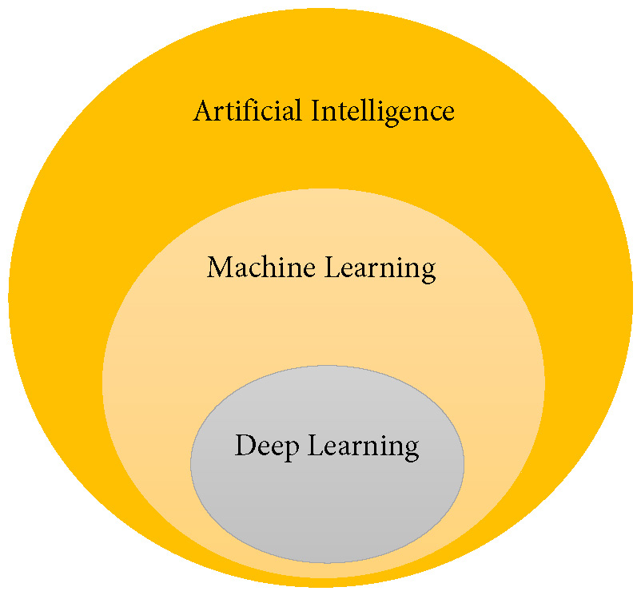
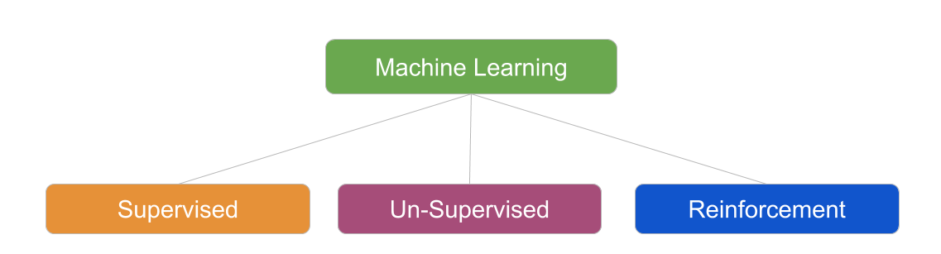
Machine Learning Fundamentals
What is Machine Learning (ML)
ML is subset of AI
ML is inferring knowledge from data
"Field of study that gives computers
the ability to learn without being
explicitly programmed"
By Arthur Samuel
Types of ML
Application:
Image Recognition
Recommender Systems
Transport

Slide 5
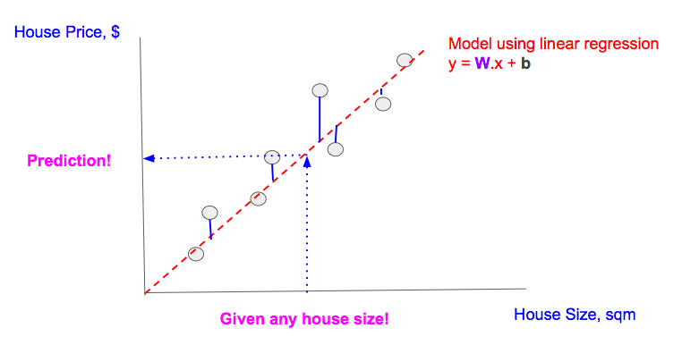
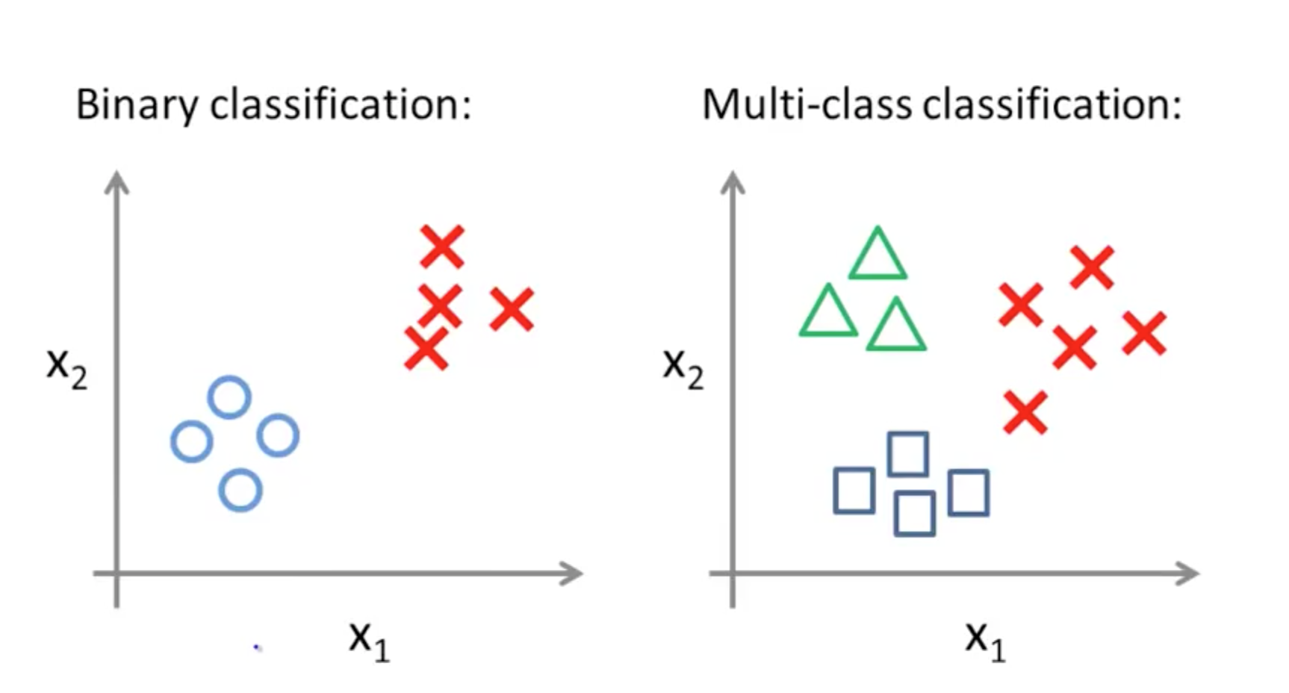
Machine Learning Fundamentals: Supervised Learning
Supervised Learning: Prediction of Labeled Data
Types
Regression
Classification

Slide 6
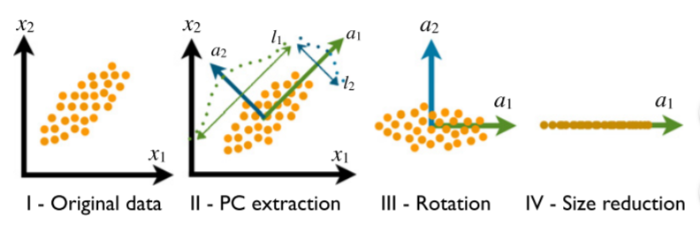

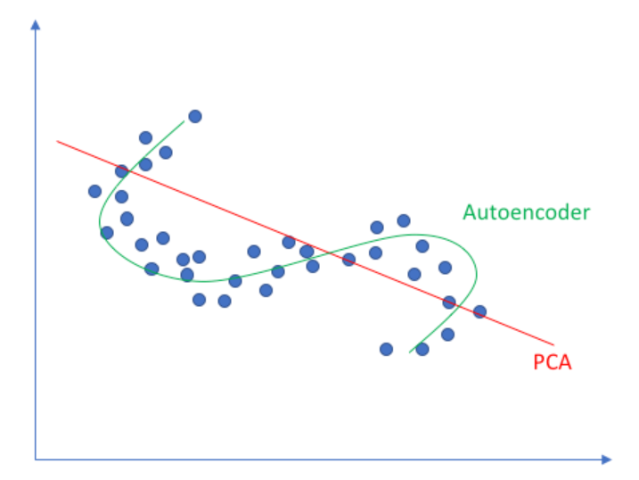
Machine Learning Fundamentals: Unsupervised Learning: Data Reduction
PCA:
Eigenvectors and eigenvalues
of the covariance matrix
Directions of the principal
components
Sort the eigenvalues
Project the data set in
the new representation.
Autoencoders:
two parts: encoder and decoder
output wanted to be as close as
the original input
PCA vs Autoencoders
Linear vs Nonlinear

Slide 7
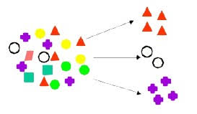
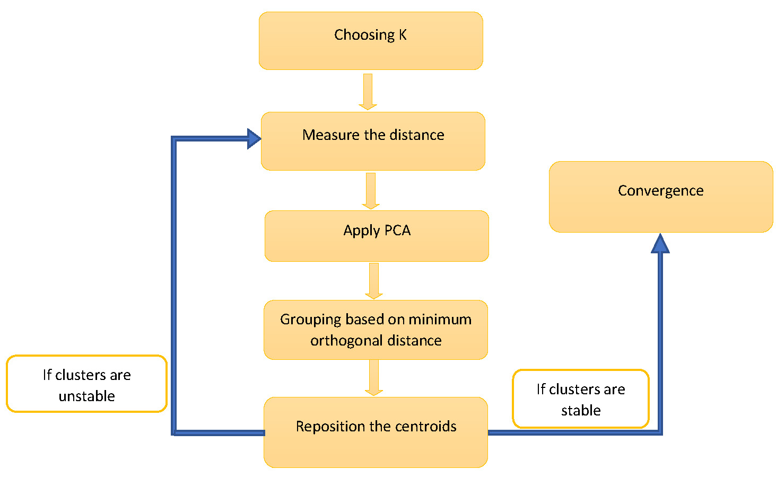
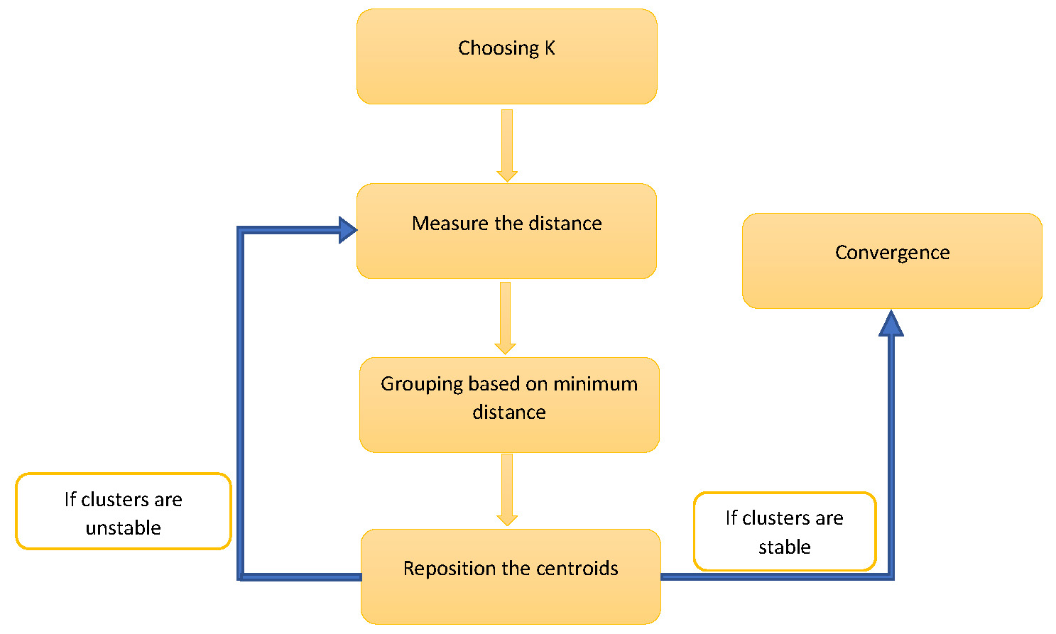
Machine Learning Fundamentals: Unsupervised Learning: Clustering
Clustering:
Dividing data into Clusters
K-Means:
Euclidien distance
Local PCA:
Orthogonal distance

Slide 8
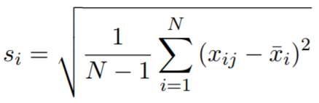
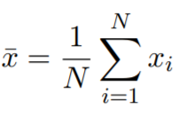
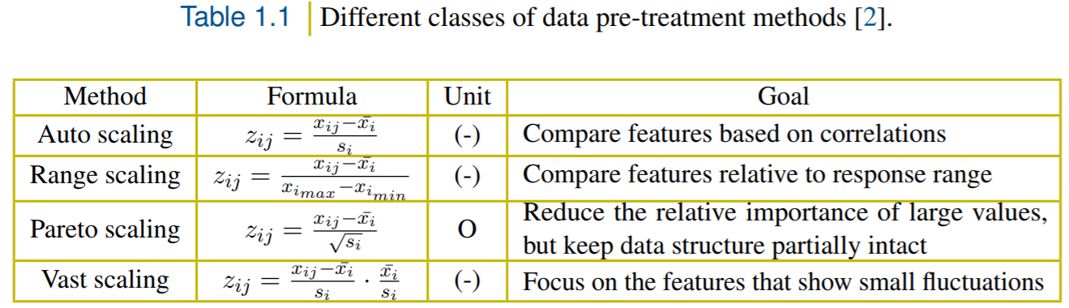
Feature Scaling
Different scaling methods

Slide 9
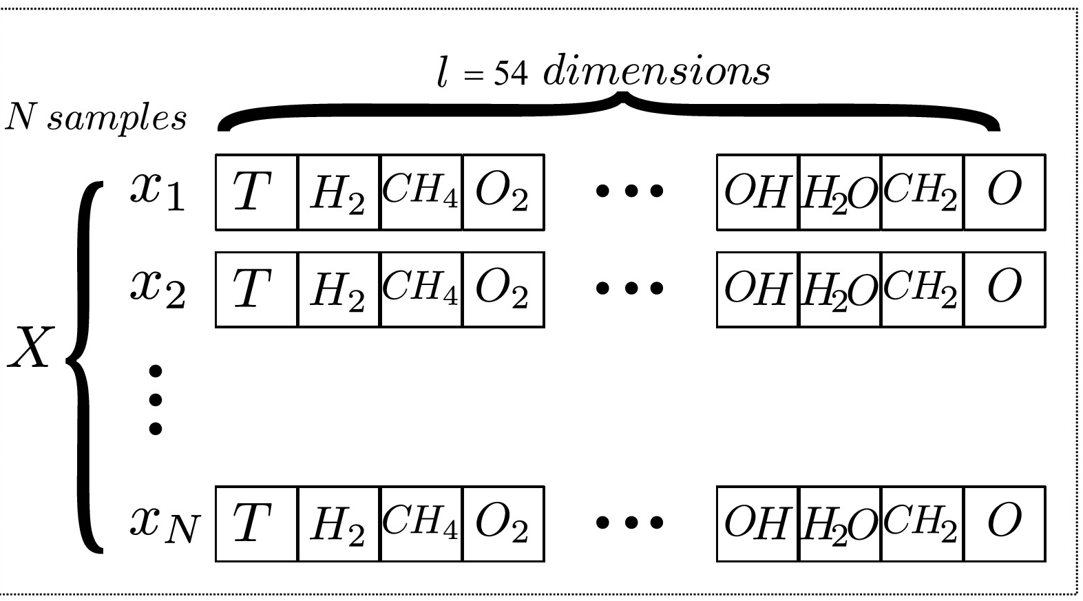
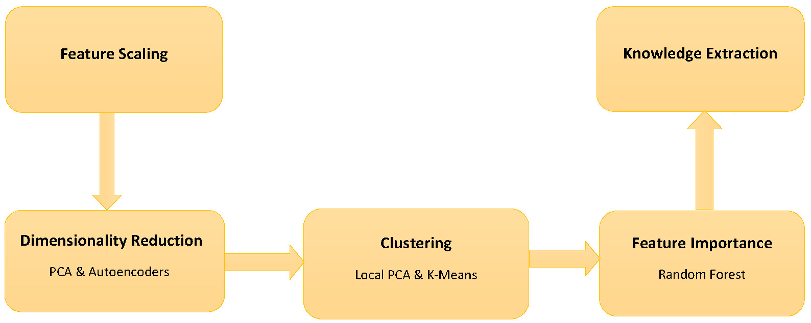
Case Study: Combustion data
Simulation: Combustion Data
Freely-propagating premixed flame (FPF)
Dataset with 5600 samples and 55 dimensions.
Different Inlet Temperature: 300, 500, 700, 900 K
Dataset with 26,000 samples and 55 dimensions
FPF with varying inlet temperature (TFPF)
Methodology

Slide 10
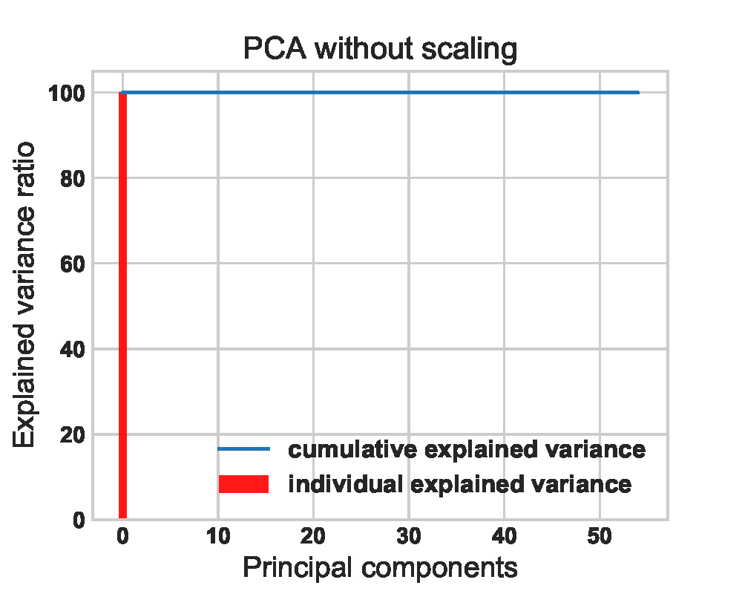
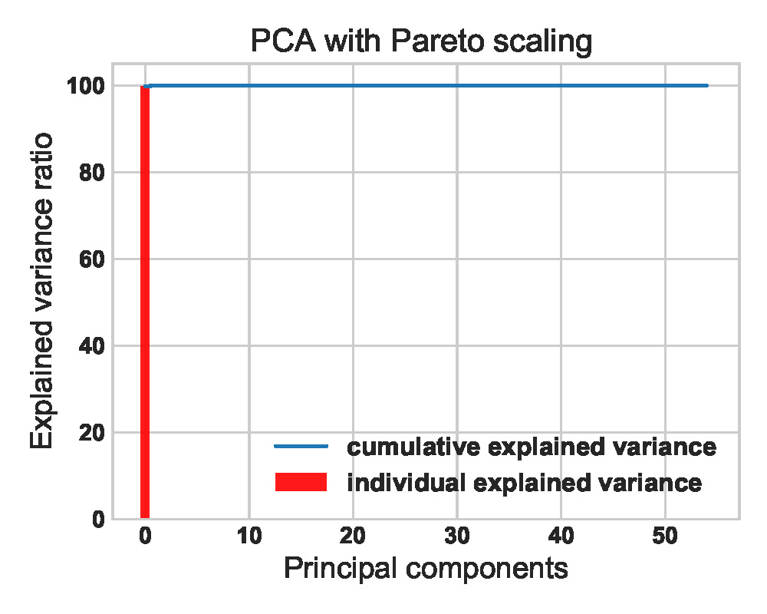
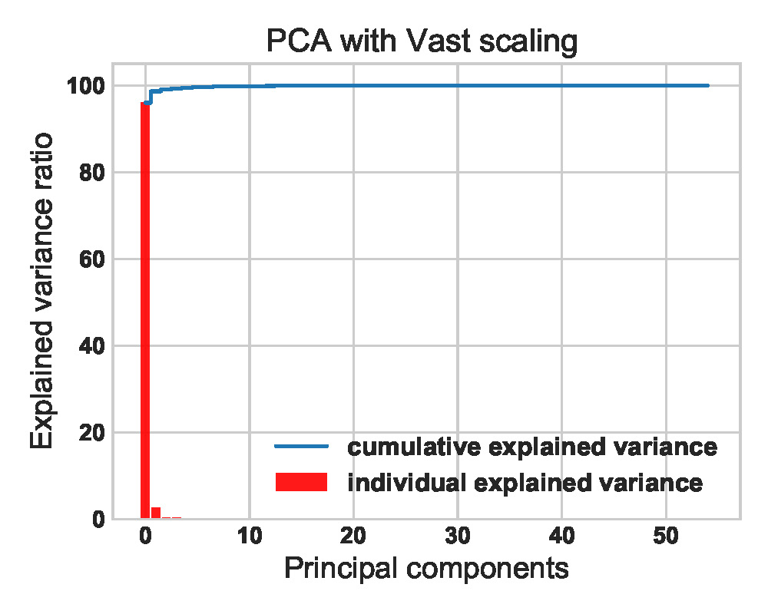
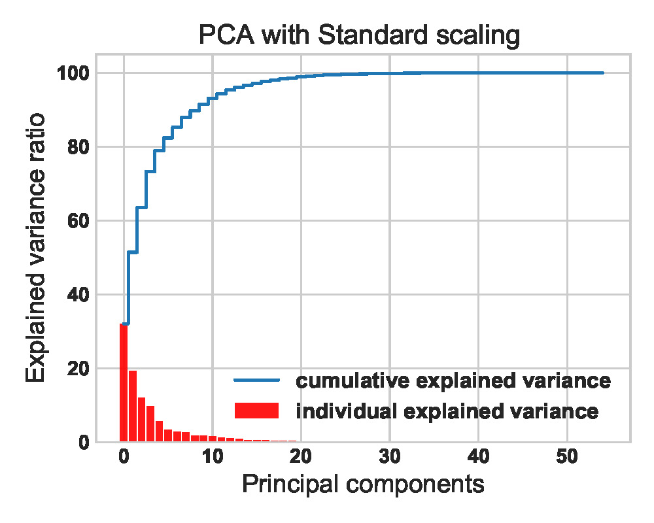
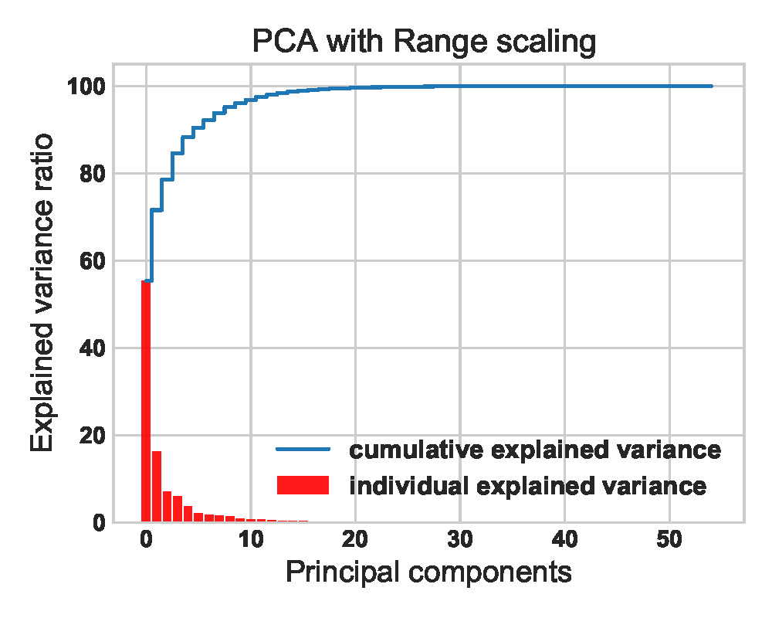
Dimensionality Reduction: PCA Results
PCA: TFPF dataset
Different scaling methods
Selecting PCs

Slide 11
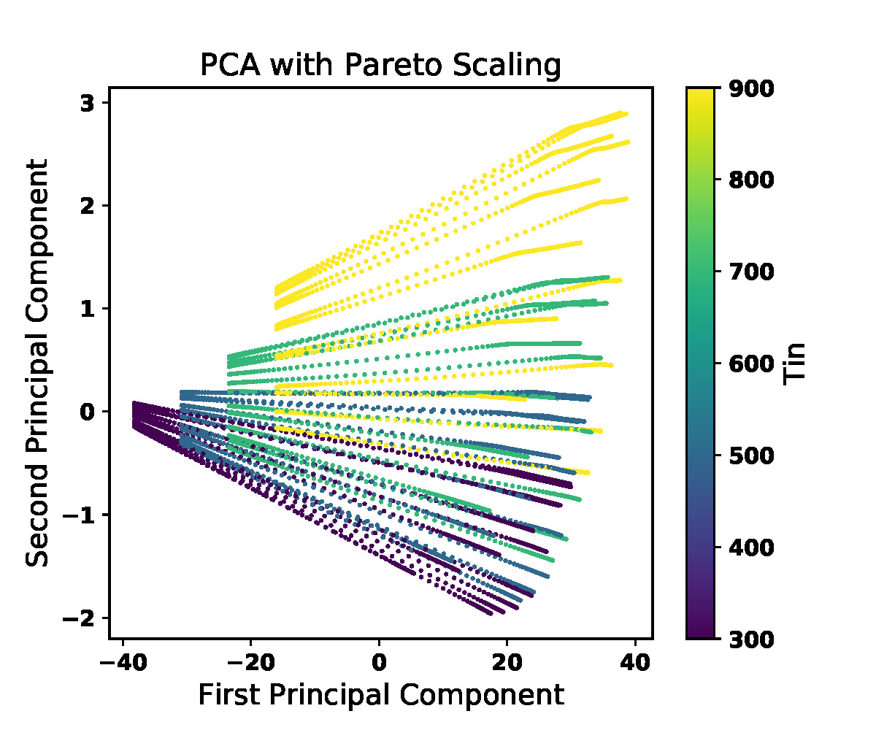
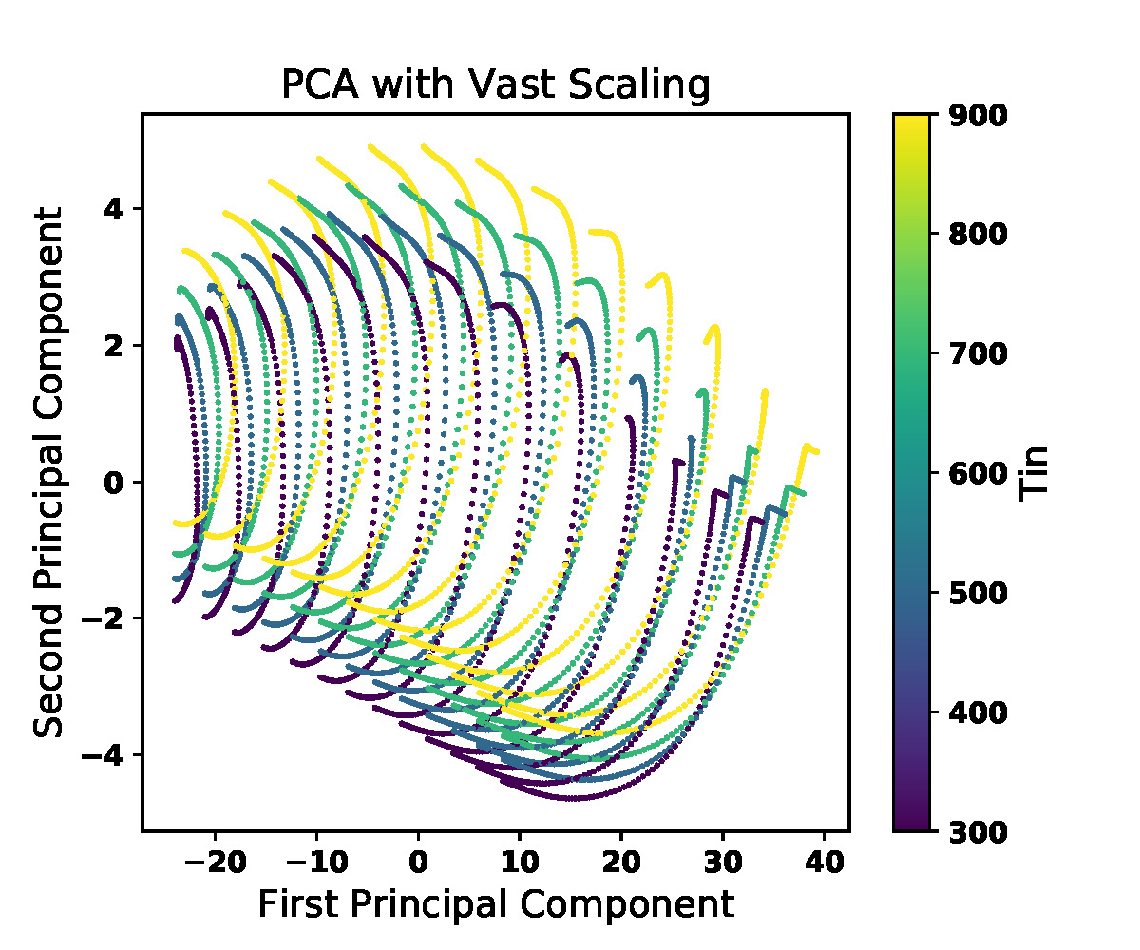
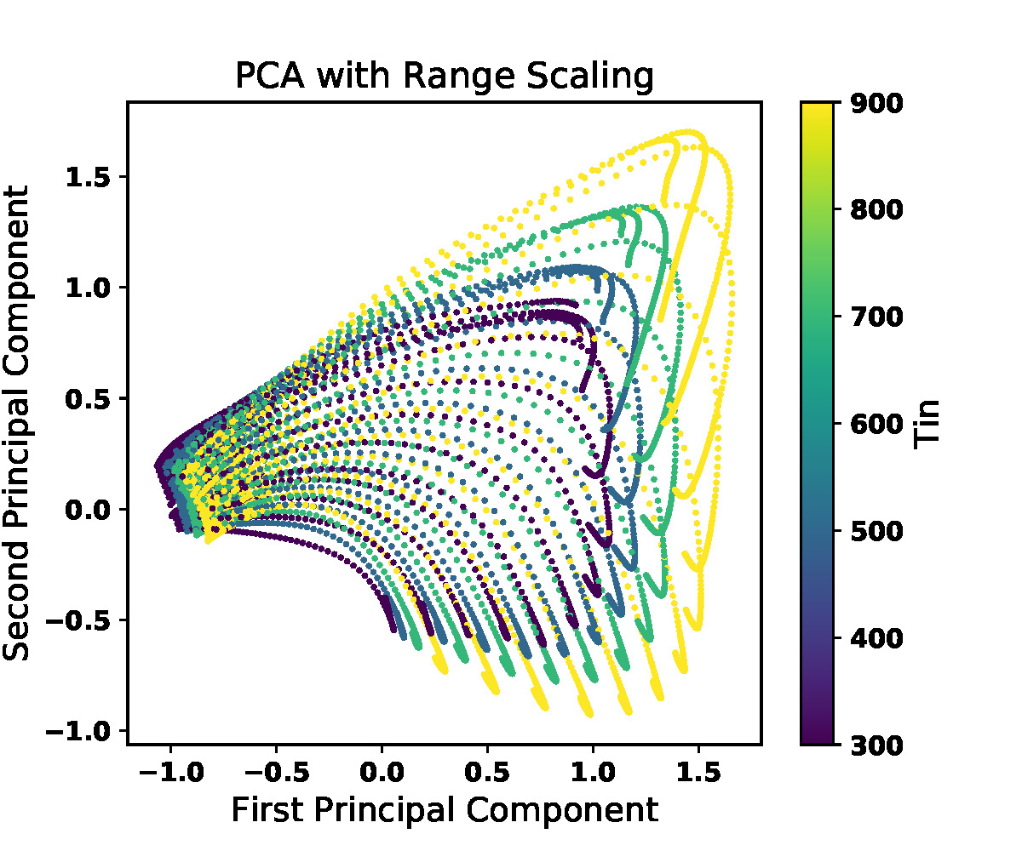
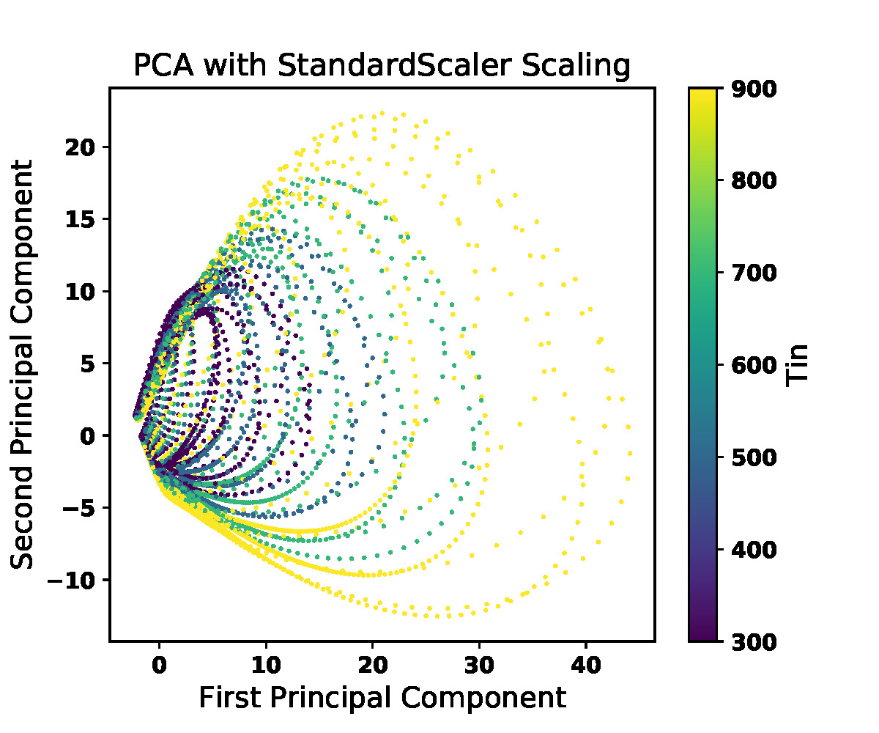
Dimensionality Reduction: PCA Results
PCA:
PC1 vs PC2
4 maps
13 distinguishable trajectories
Different equivalence ratio
52 trajectories in total

Slide 12
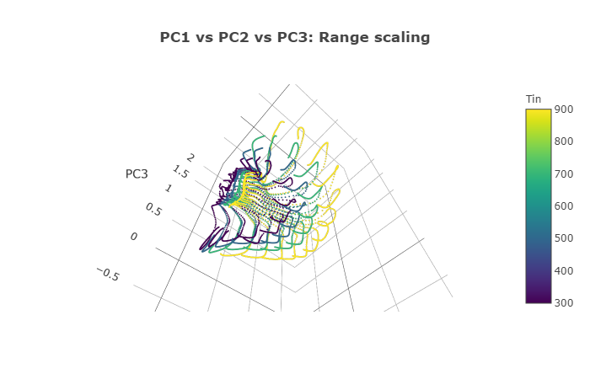
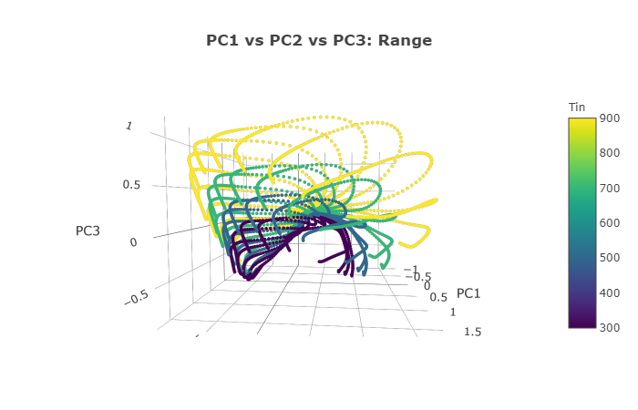
Dimensionality Reduction: Autoencoders Results
Autoencoders
Similar to PCA

Slide 13
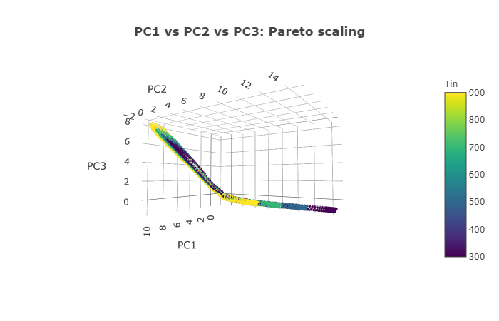
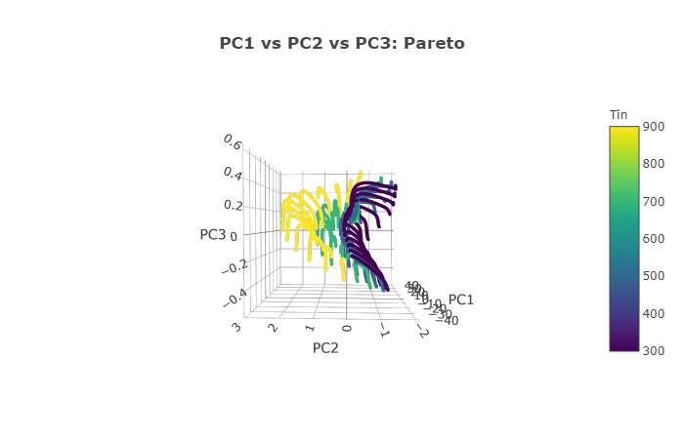
Dimensionality Reduction: Autoencoders Results
Autoencoders:
Very sensitive to scaling

Slide 14
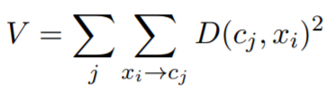
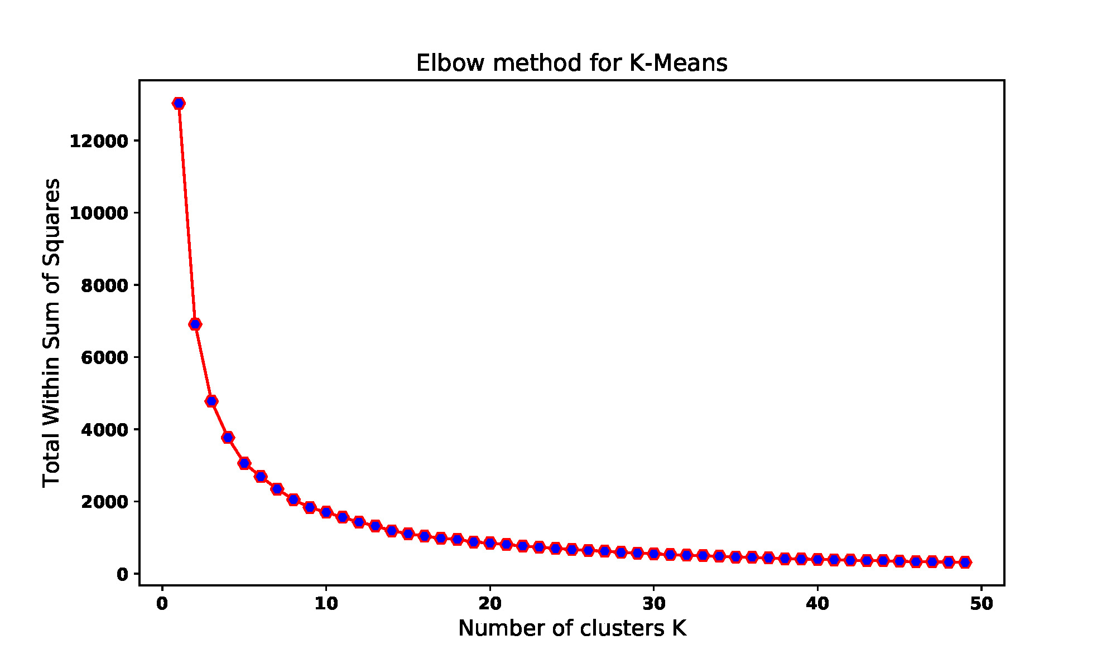
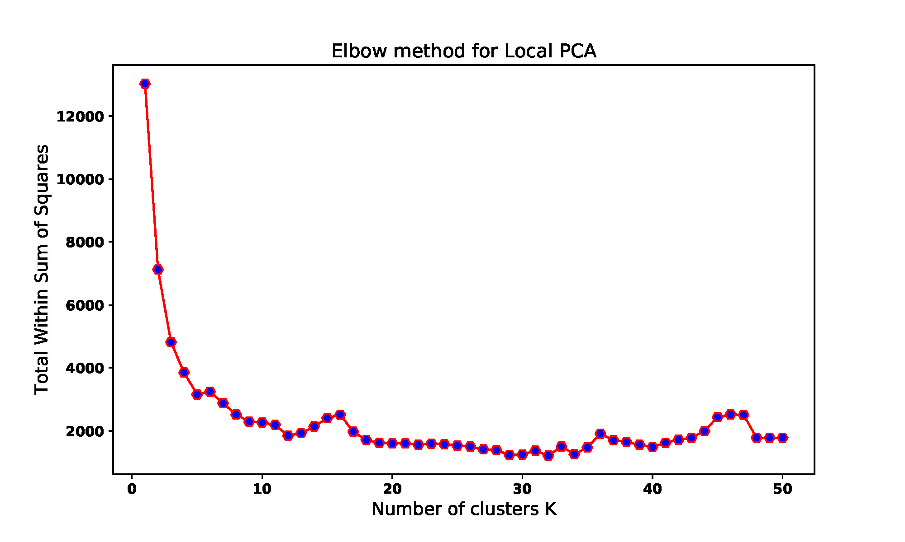
Clustering Analysis: Results
Elbow method: Number of cluster to choose
Elbow: Variance no longer decreases significantly

Slide 15
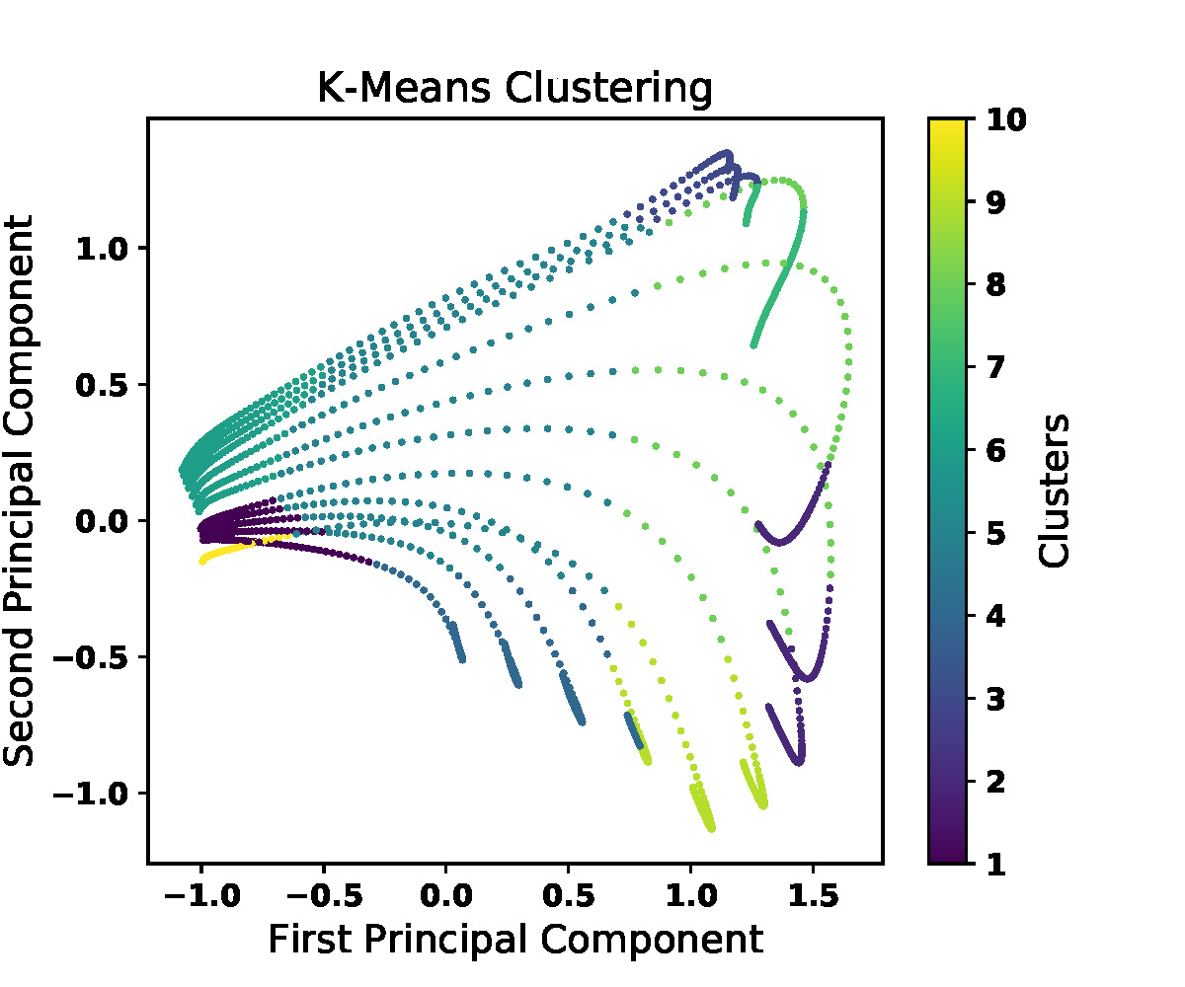
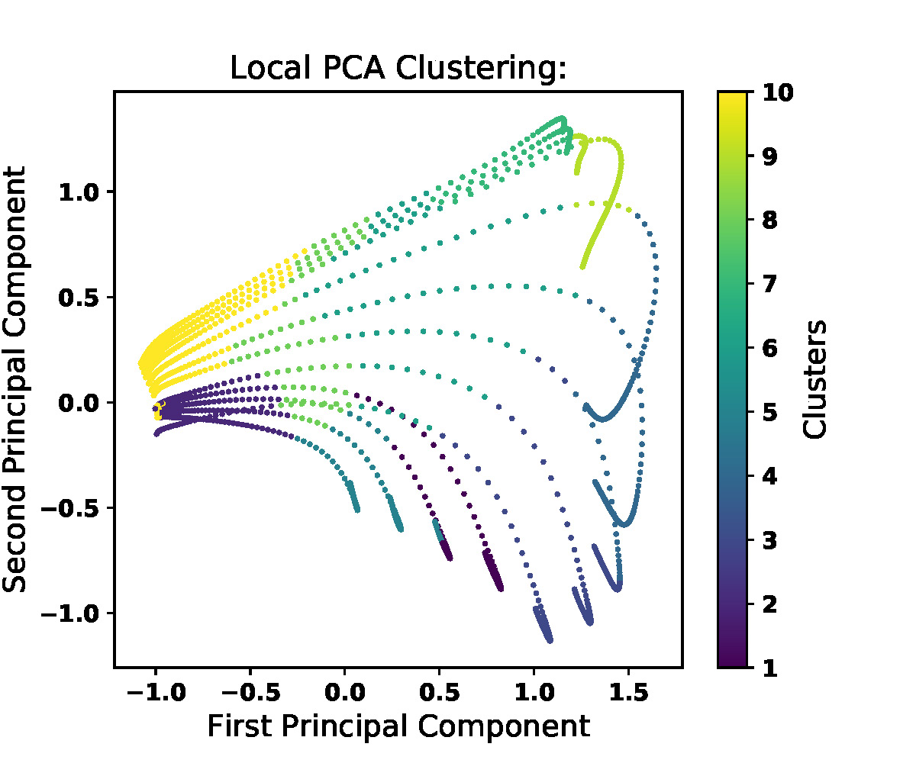
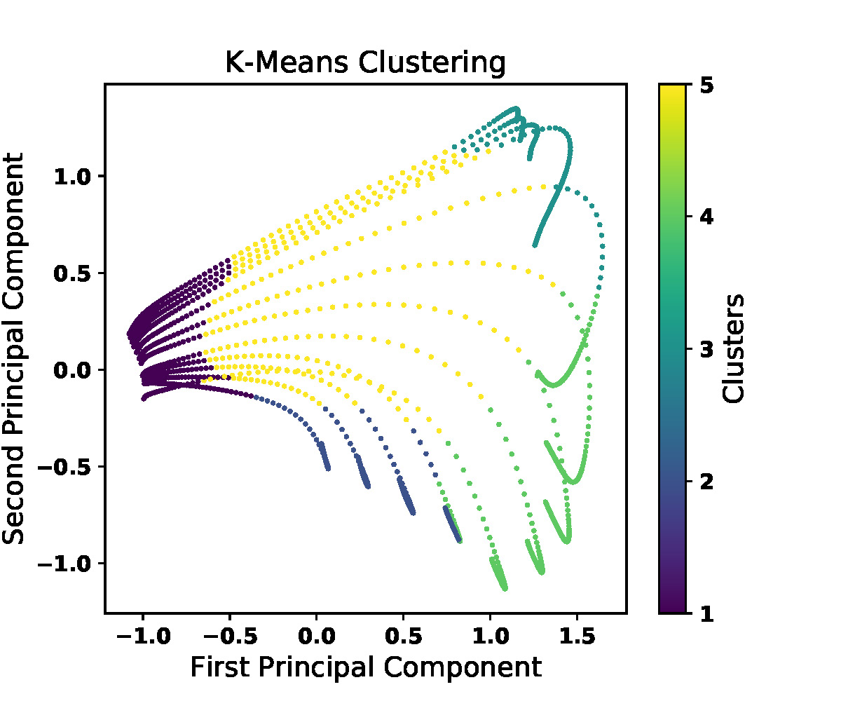
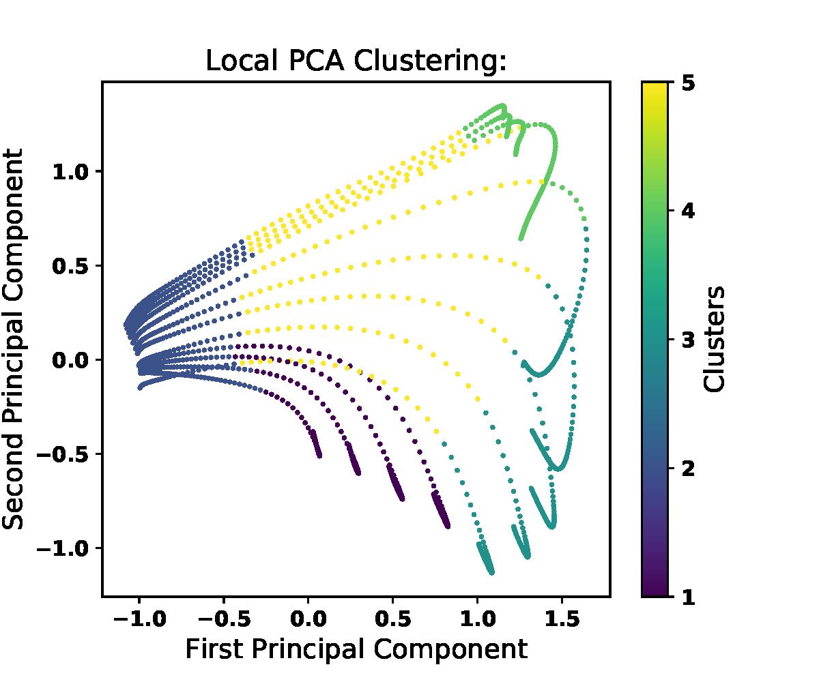
Clustering Analysis: Results
FPF dataset at 300k
10 Clusters:
Effect of equivalence ratio
5 Clusters:
Effect of ER is reduced

Slide 16
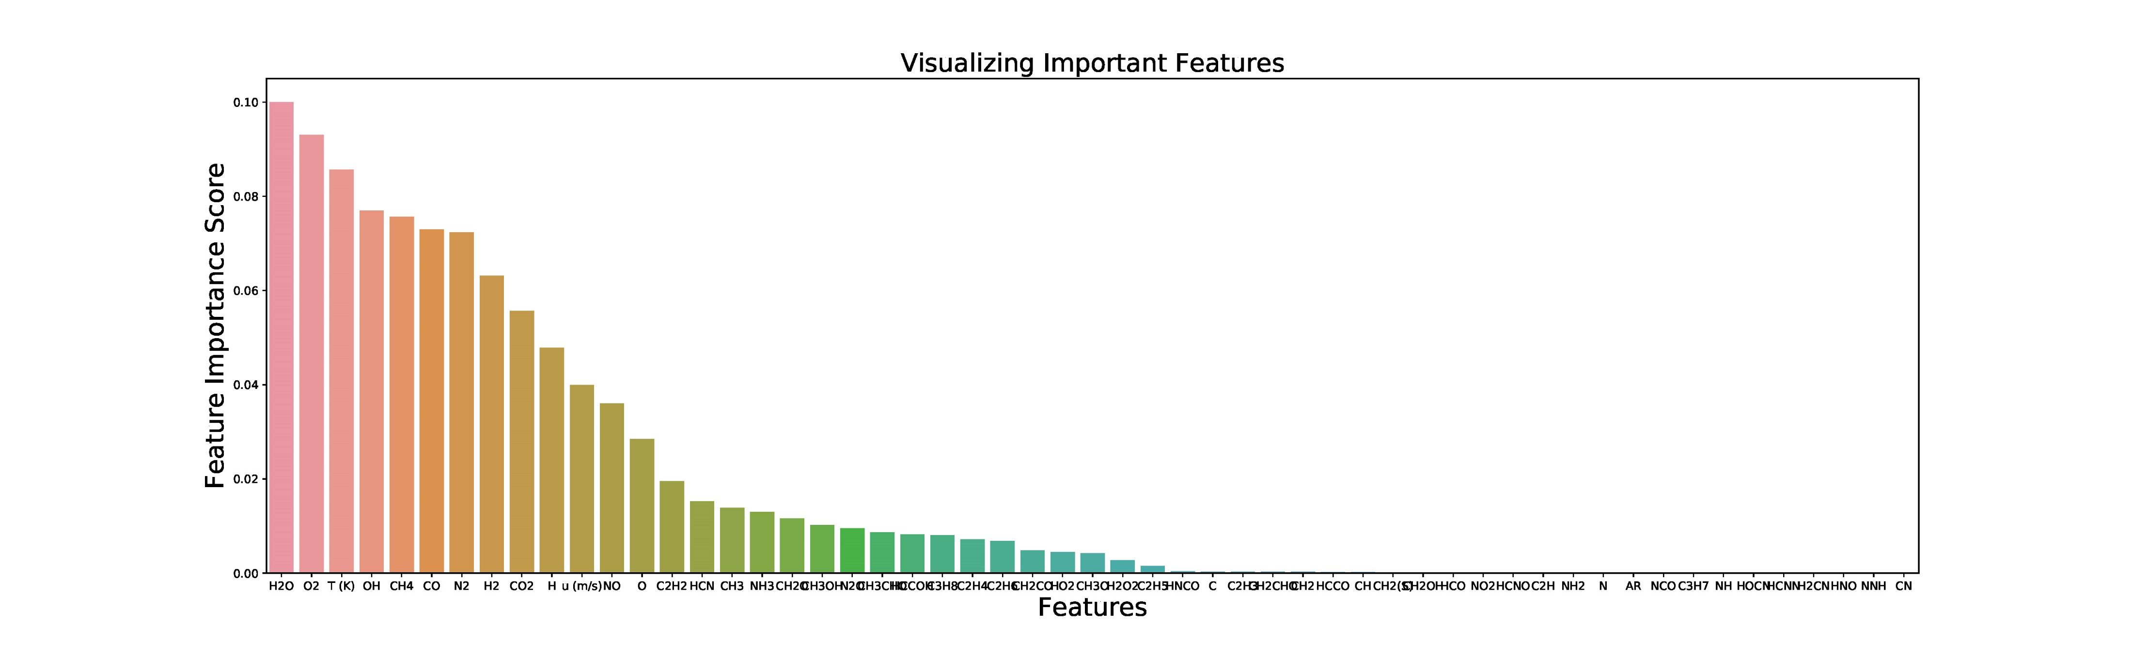
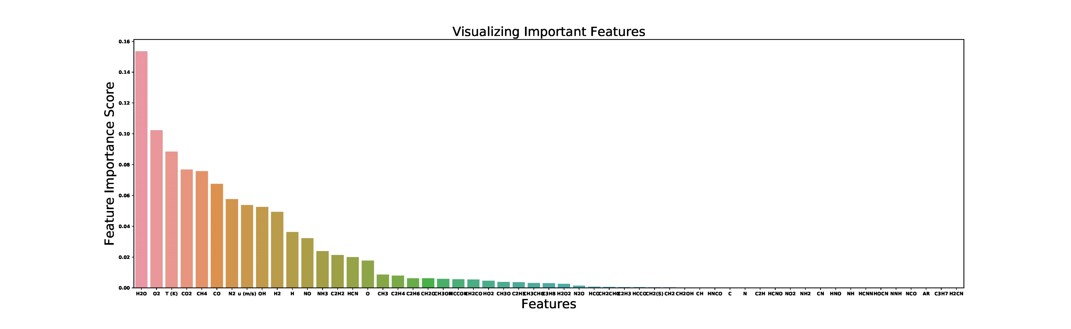
Feature Selection
Random Forest Classifier: Feature Selection

Slide 17
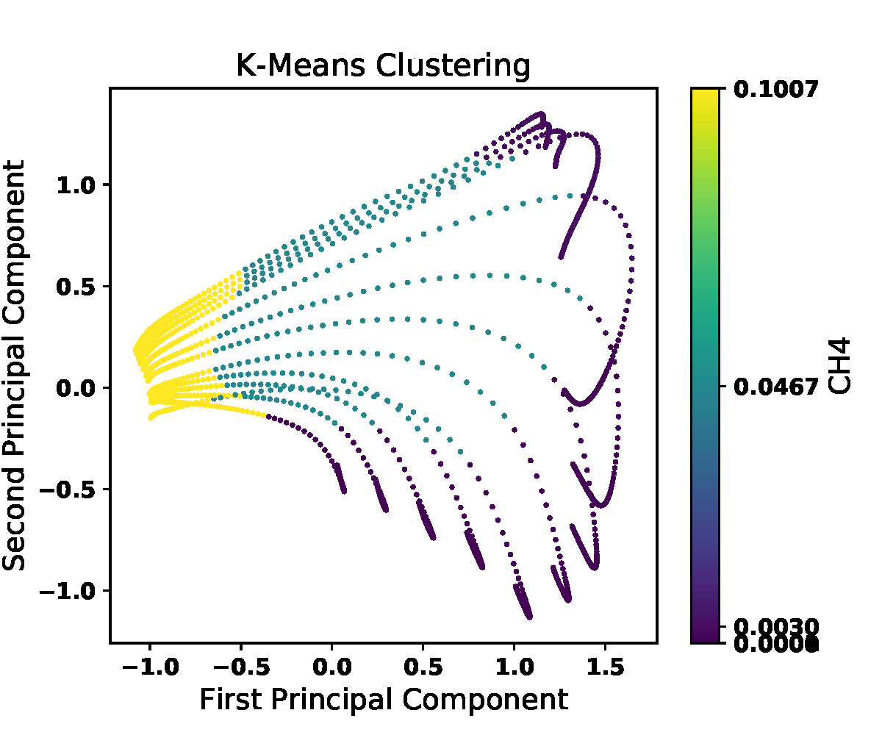
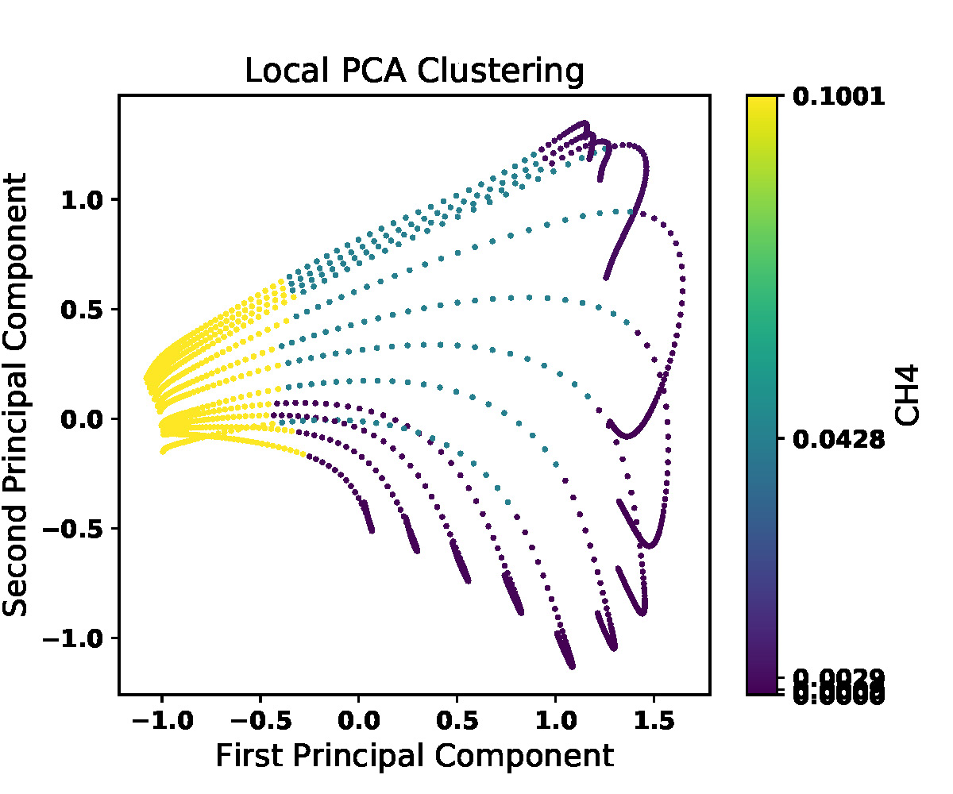
Clustering Interpretation
Label:
Clusters index
Label:
Average values of CH4

Slide 18
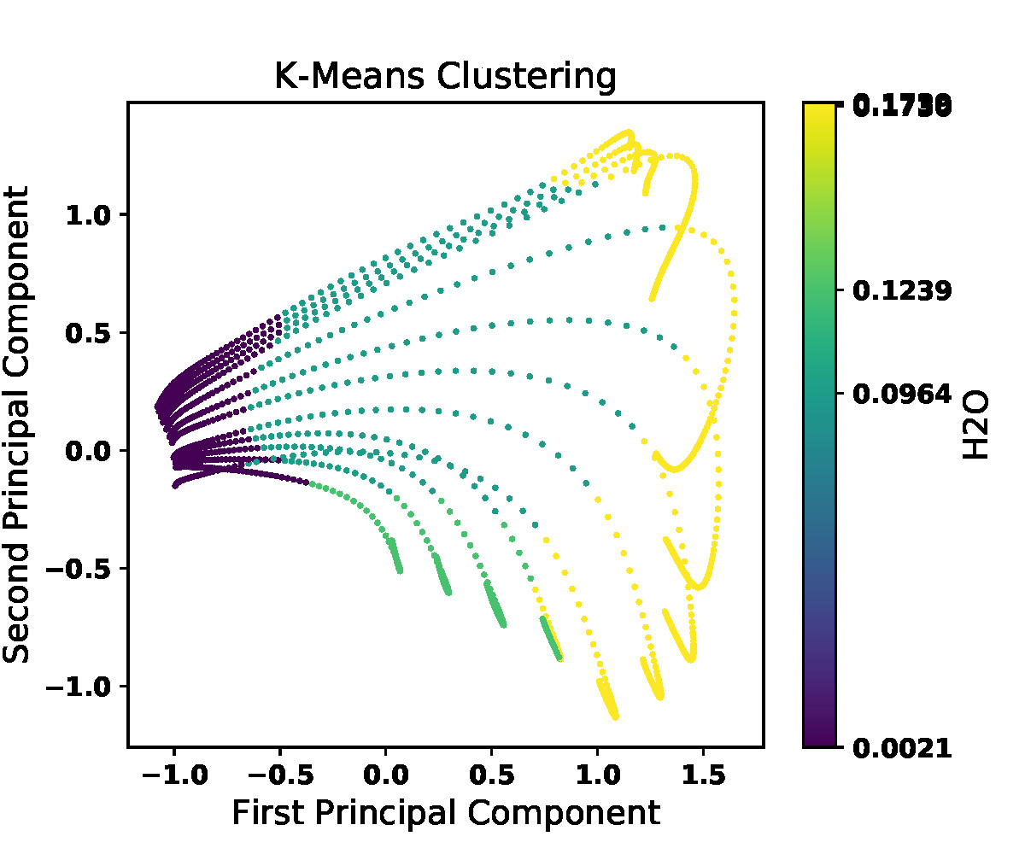
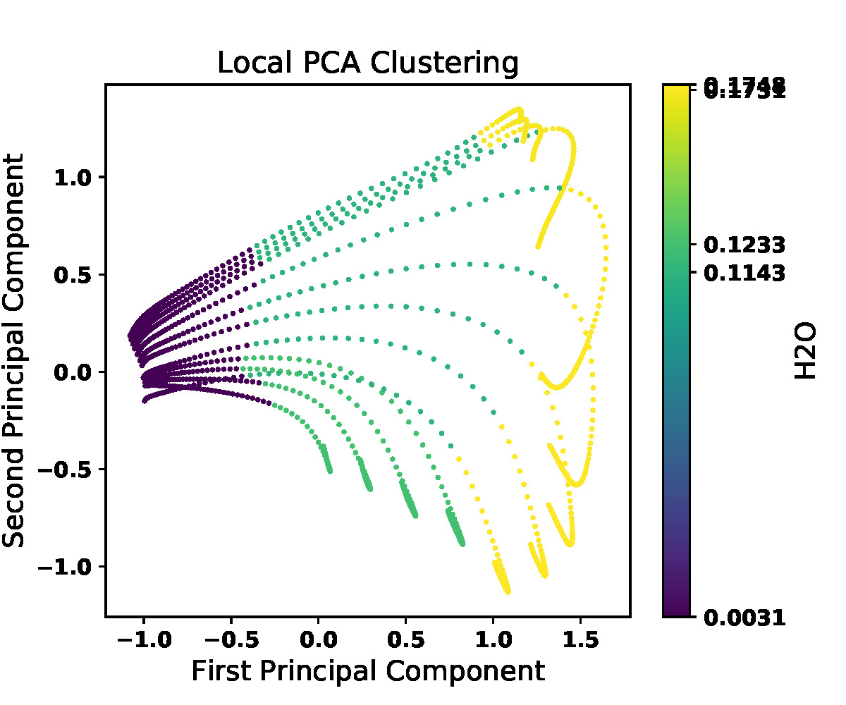
Clustering Interpretation
Label:
Clusters index
Label:
Average values of H2O

Slide 19
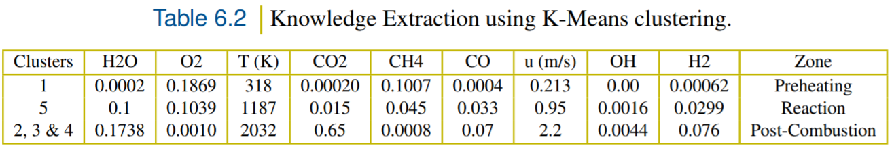
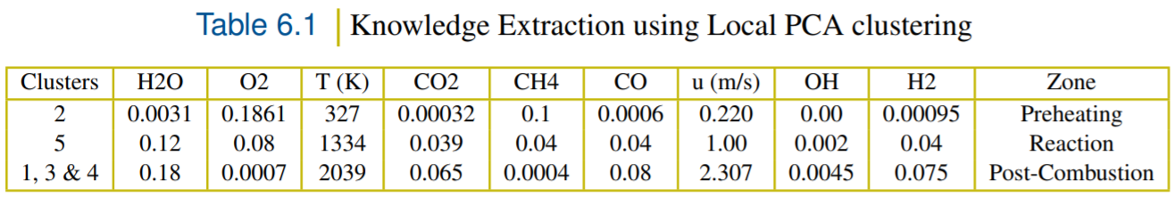
Clustering Interpretation
3 zones have been identified

Slide 20
Conclusion
Conclusion:
Review of Machine Learning techniques
such as Dimensionality Reduction and Clustering
Influence of Feature Scaling methods
on PCA and Autoencoders performance
Effect of the equivalence ratio on
the clustering formulation
Use of Random Forest classifier to identify
the most important features
Identification of 3 different zones:
Preheating, Reaction and Post-Combustion zone

Slide 21
Thank you for your attention!

